Slide 1
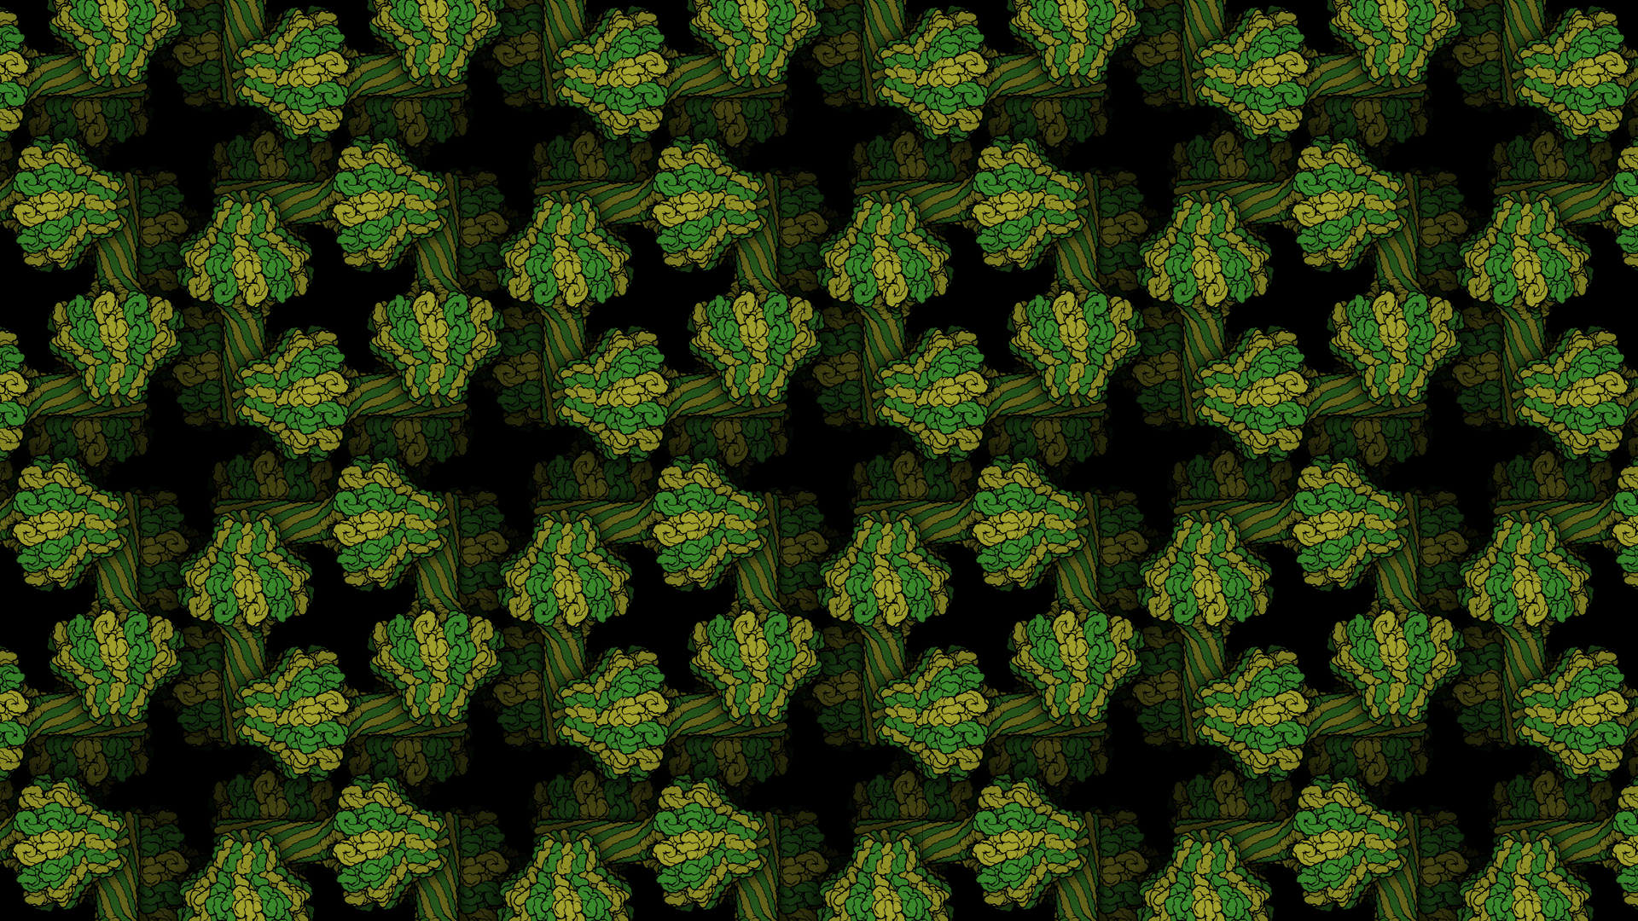
Molecular Visualization: Pymol
Evan Edelstein
edelsteinevan@gmail.com
Notes:
https://pdb101.rcsb.org/learn/other-resources/molecular-backgrounds-for-virtual-meetings

Slide 2




Downloading and Running Pymol:
Educational license: https://pymol.org/edu/?q=educational/
Open-Source version: https://github.com/schrodinger/pymol-open-source/blob/master/INSTALL
Academic Use: Open ticket with Einstein IT: https://itsupport.einsteinmed.org/
To access Pymol:
Open a terminal or command prompt and type: Pymol
Notes:
Warren L. DeLano

Slide 3
Pymol Resources:
PyMOL is open source and user sponsored software. There is a lot of stuff you can do in PyMOL. You might start here:
http://pymolwiki.org/images/7/77/PymolRef.pdf
http://pymolwiki.org, explore on your own, for example
Look at the tutorials
Learn selections properly: http://pymolwiki.org/index.php/Selection_Algebra
Check out the various plugins or the “gallery” and learn how to make the various illustrations (http://pymolwiki.org/index.php/Gallery)
Make a nice illustration of your favourite structure from the PDB?
Learn how to make this picture: http://pymolwiki.org/index.php/File:QuteMolLike.png
http://www.pymol.org

Slide 4
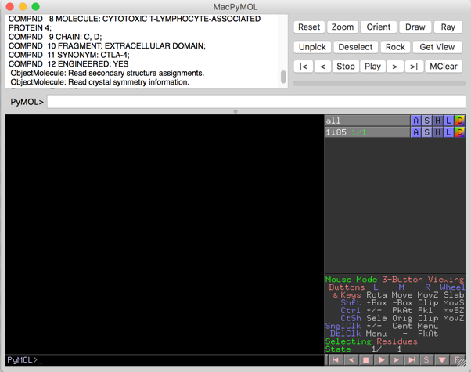
Pymol Interface:
Command Line
Object Menu
Panel
Display Area
Mouse controls
Command Line
Movie controls

Slide 5
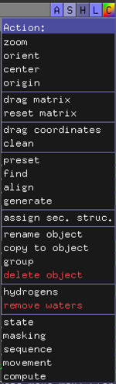
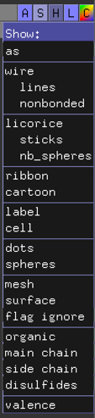
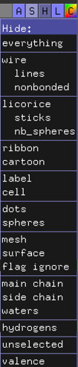
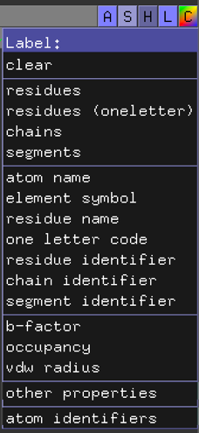
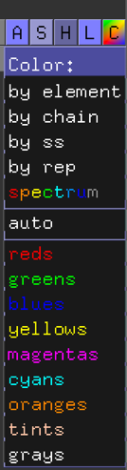
Selection Interface:

Slide 6
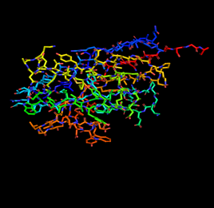
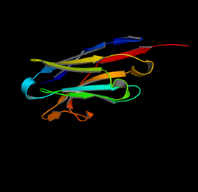
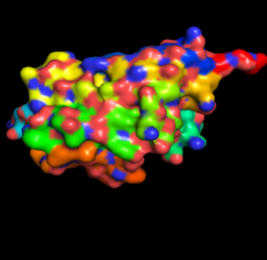
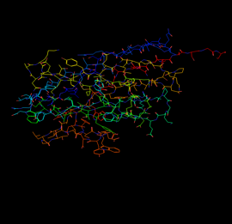
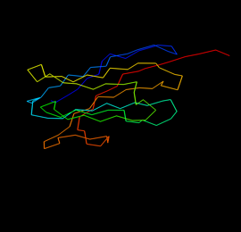
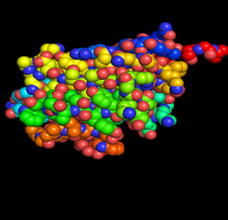
Representing Molecules:
Sticks
Cartoon
Surface
Lines
Ribbon
Spheres

Slide 7
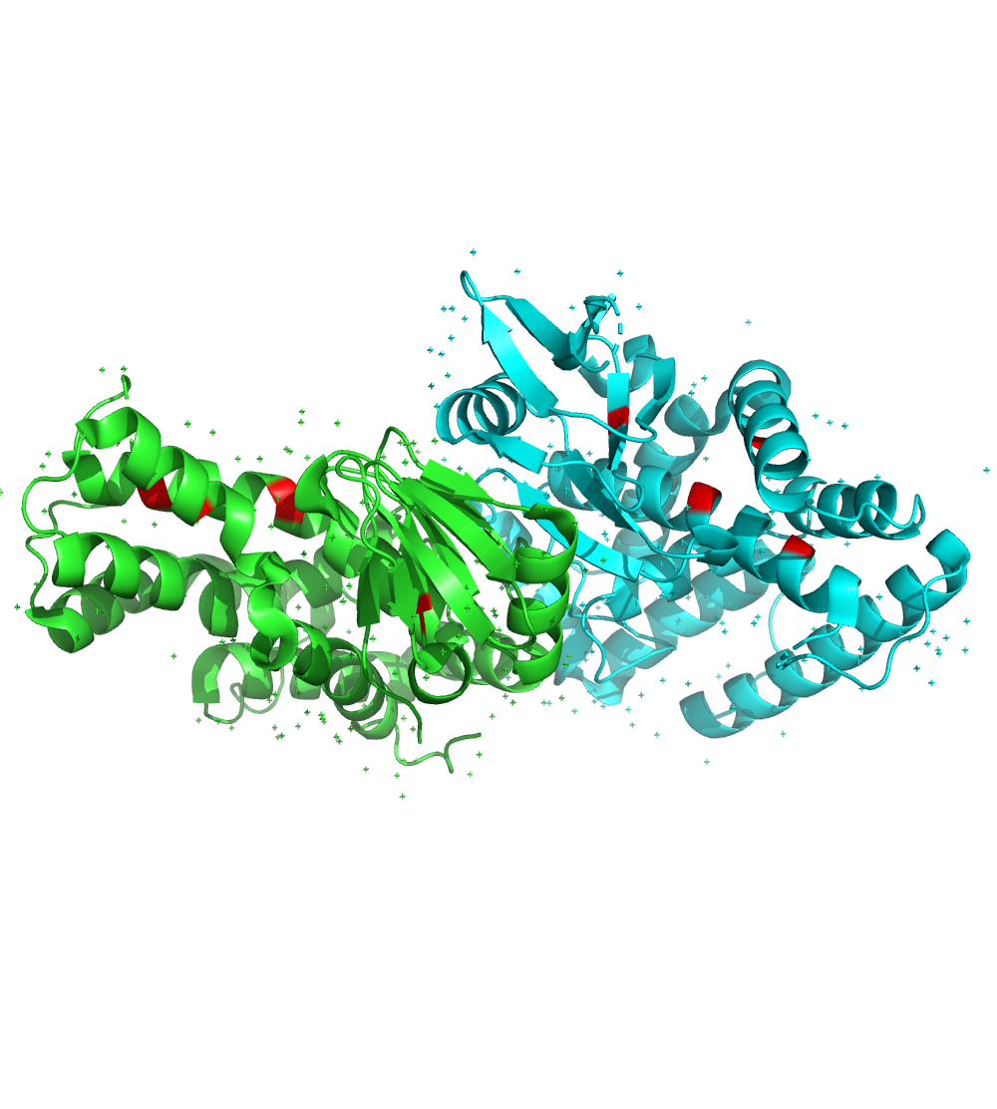
The Essence of Pymol:
Ask a Specific Biological Question
Translate the Question Into a Pymol Selection
Analyze the Selection to Formulate a Hypothesis
Example
Question: Is there a stabilizing disulfide bridge at the interface?
Selection: ‘select cystines, resn CYS’
Hypothesis: No, it doesn’t seem that CYS-CYS interactions are important at this interface.

Slide 8
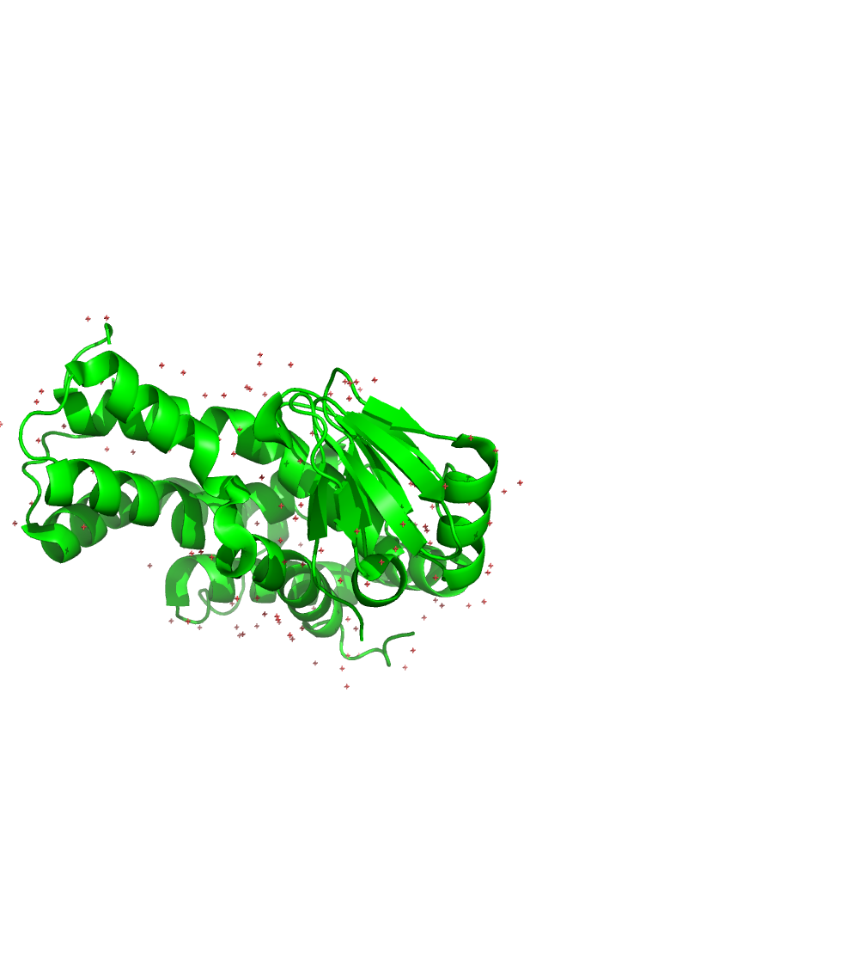
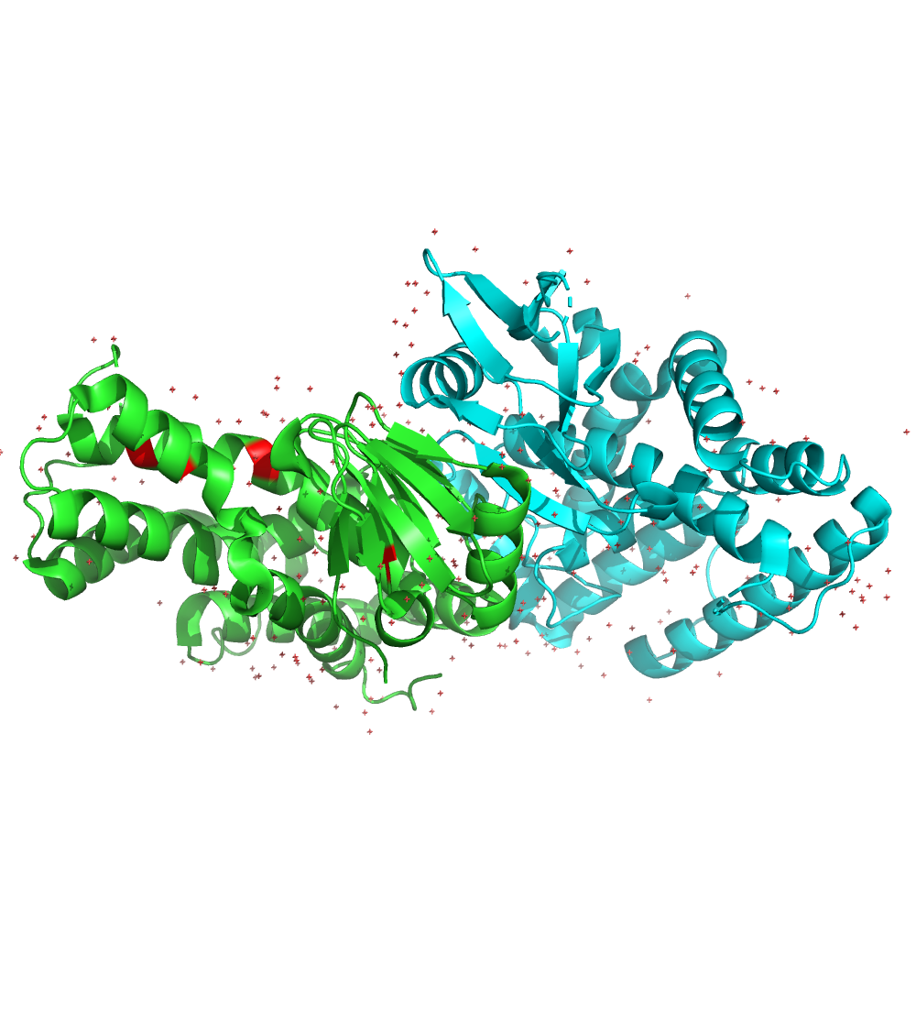
Selection Algebra:
Using pymols selection algebra allows for programmatic and fine-tuned manipulation of protein structures.
highlight all cystines red:
select cystines, resn CYS
color red, cystines
show only chain A and B:
Select A, chain A
hide everything, not A
Combine the two selections:
select cys_A, chain A and resn cys
color red, cys_A

Slide 9
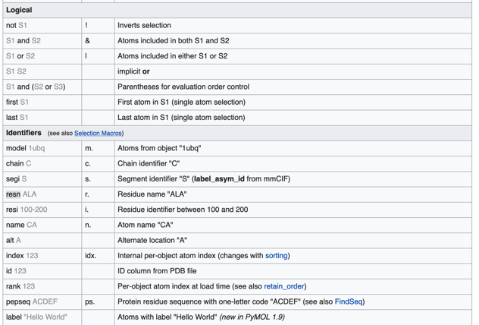
Selections and Objects:
Selections allow for manipulation of part of a protein:
select `name`, `selection algebra`
Selections will appear wrapped in parenthesis.
Selections can also be made by clicking on a structure.
Selections cannot override behavior of parent objects
Instead generate an object from a selection:
create `object name`, `selection name`

Slide 10
Pymol Functions:
Pymol has built in functions for many basic manipulations of selections or objects:
Load: load `filename`
Fetch: fetch `pdbid`
Select: `name`, selection algebra
Create: `name`, selection algebra
Extract: `name`, selection algebra
Color: color `color`, `selection`
Representations: show ` representation` , `selection`
Label: label `selection`, `label`
Distances: distance `selection1`, `selection2`
Align: align `selection1`, `selection2`
Save: png `filename`

Slide 11
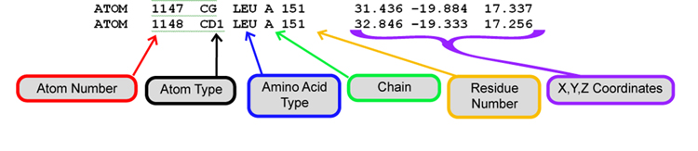
Molecular Data Structures:
3D Macromolecule data is stored in a pdb file.
Pdb files for solved structures can be found at https://www.rcsb.org/
Proteins are accessed by four alpha-numeric ids optionally followed by a single letter chain id.
Pdb files contain atomic data, coordinate data and misc. data in the header section.

Slide 12
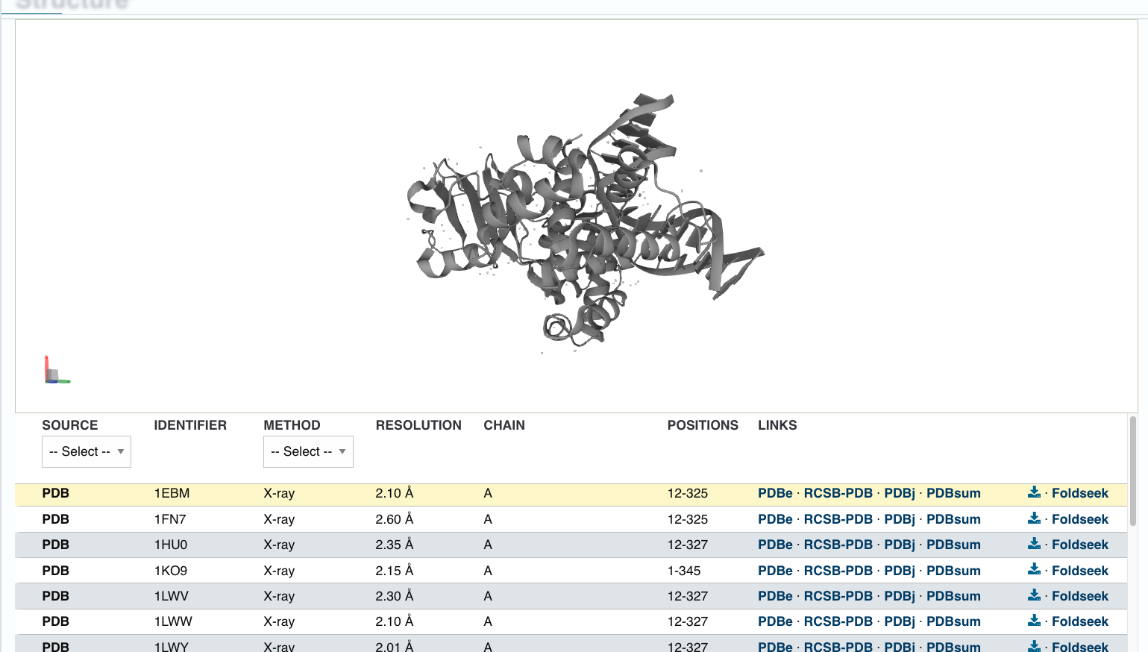
Accessing Structure Data:
Macromolecule sequence and structure information can be found at https://www.uniprot.org/uniprotkb/ or https://www.rcsb.org
The sequence and 3D structure of Macromolecules are represented as PDB files. These files contain chemical, coordinate and chain information in a row-wise schema. Additionally, a header provides useful information about the structure.
For example, lets look at 8-oxoguanine DNA glycosylase: https://www.uniprot.org/uniprotkb/O15527/
Exercise Questions:
What is the PDB identifier for the structure with the best resolution?
What is the resolution for structure 1EBM?
Are any of the structures for the full-length protein?
Are there any visible hydrogen atoms in any of the structures? Why not?
Notes:
Best resolution is for 2XHI. It is 1.55 Å. 1EBM has 2.10 Å resolution. The only full-length structures are 1KO9 and 2XHI. With a resolution ~1.6 Å or worse one cannot reliably predict the positions of the H atoms from the electron density.

Slide 13
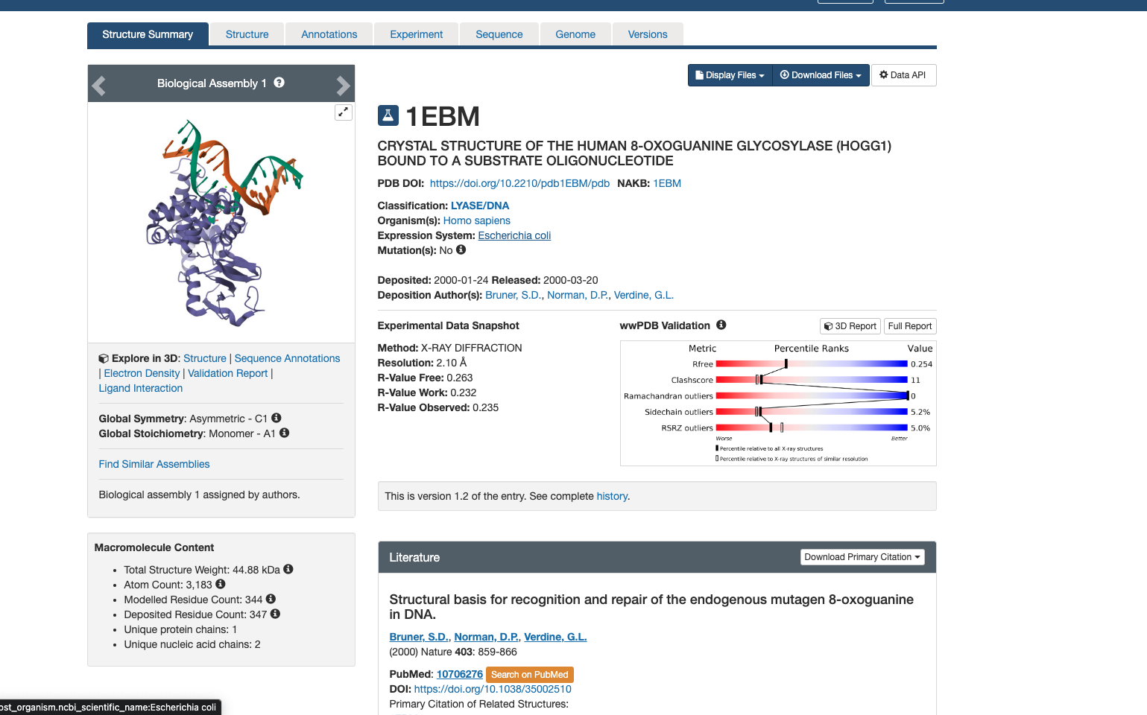
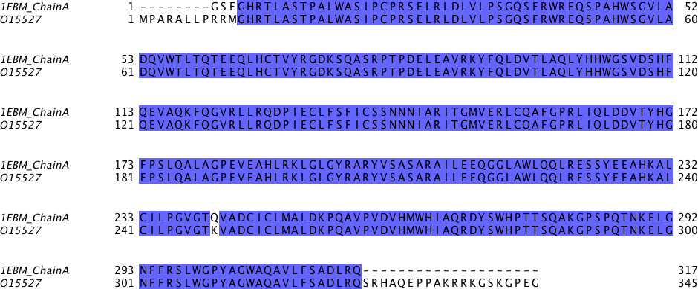
Accessing Structure Data 2:
Let's look at the RCSB entry for 1EBM containing experimentally determined structures:
Which macromolecules does this structure contain? How many chains are there? What is chain A? Is it mutated? What other information is present on the RCSB entry?
What data can we get from the PDB header. Who are the authors of this work? Is this an X-ray crystallography or NMR study? What is the resolution of the structure? What do you find in the fields “REMARK 200”? Did they use a synchrotron for this work? What do you find in the fields “REMARK 465” and “REMARK 470”? Can you explain the missing residues/atoms? What do you find on the “SEQRES” lines?
Let's compare the sequence information from RCSB and uniprot?
Notes:
1EBM contains a DNA duplex and a protein, OGG1. We usually consider a DNA duplex to be one macromolecule even if the two strands are not covalently connected, thus 2 macromolecules in total. There are 3 chains, A (OGG1 protein), C and D (two strands of DNA). Chain A is the protein OGG1. It is a K249Q mutant which means Lys249 (K on blue background on previous page) has been mutated to Gln. It is not a full-length protein. Residues 1 to 11 and 326 to 345 have been removed (See the “Sequence” tab, and compare with the bold face residues in the sequence on the previous page). One likely reason why the researchers behind this study removed these two segments is that they are structurally disordered. Possibly they were not able to crystallize the full-length protein. The researchers expressed, in E. coli, a DNA construct comprising residues 12 to 325 of human K249Q OGG1, but put a His-tag at the N-terminus. They produced a lot of protein and used the His-tag to purify the protein. Note that residues 9 to 11 are RRM in the wild-type OGG1 (previous page), but GSE in the 1EBM structure. The residues 9 to 11 listed in the PDB file and on the PDB “Sequence” web page are parts of the linker between the His tag and the rest of the construct, and thus not really mutations of OGG1.
The authors are “S.D.BRUNER,D.P.NORMAN, and G.L.VERDINE”. This is an X-ray crystallography study. The resolution is 2.10 Å. In “REMARK 200” we find experimental details. The structure was solved using a synchrotron. “REMARK 465” and “REMARK 470” contains missing residues and missing atoms (in visible residues), respectively, in the crystal structure. These are missing since there was no visible electron density for these residues/atoms. The reason for this is that they are structurally disordered/flexible/floppy. “SEQRES” contains the sequence.

Slide 14
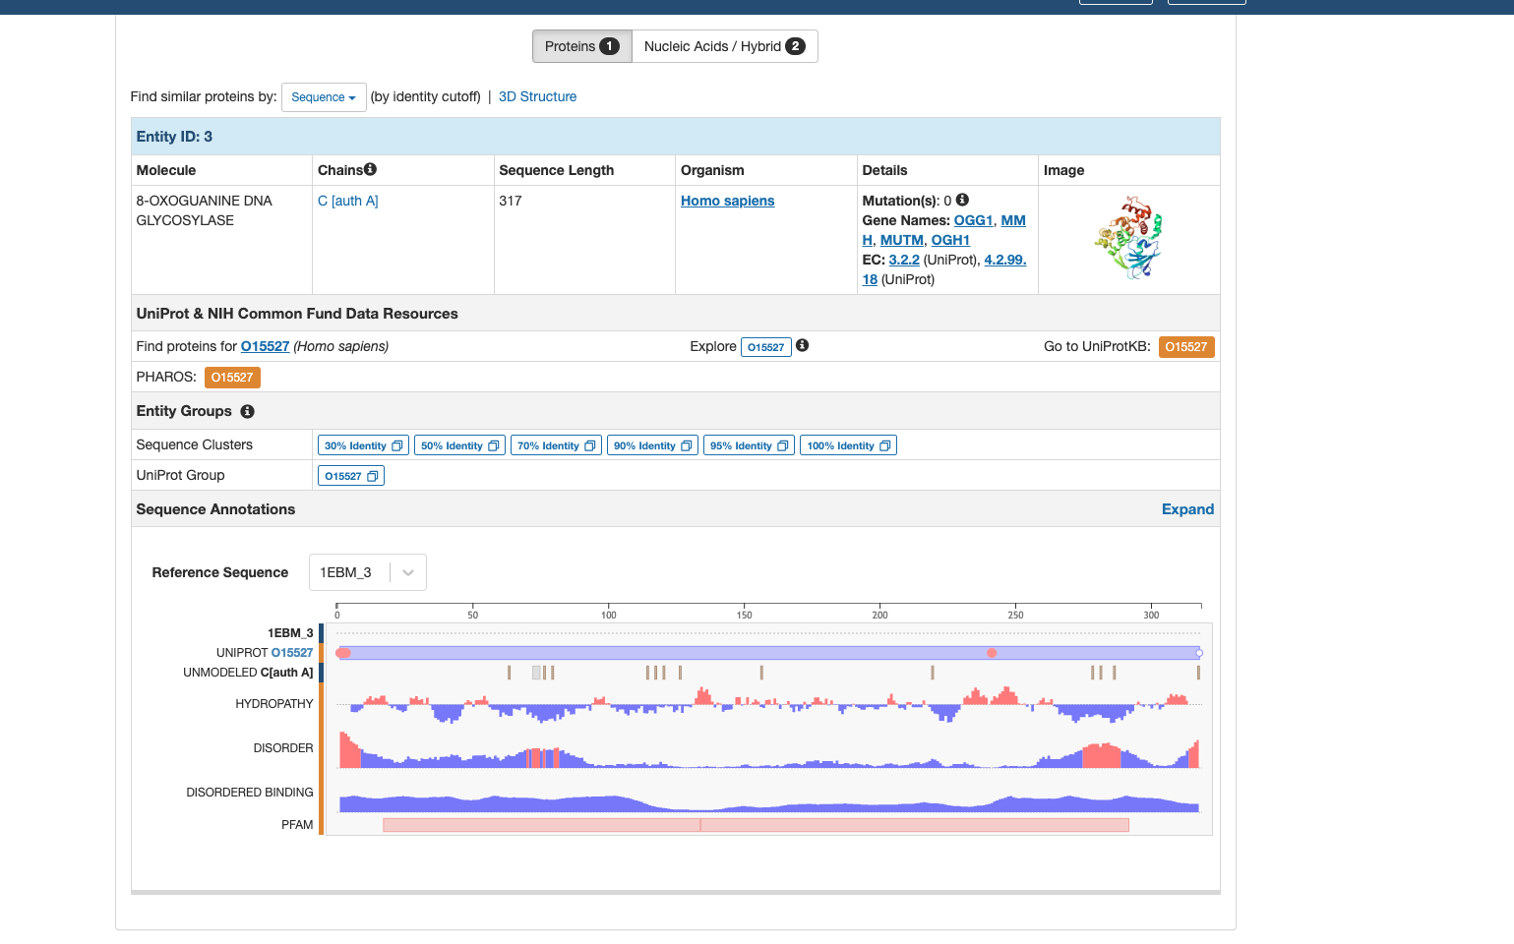

Slide 15
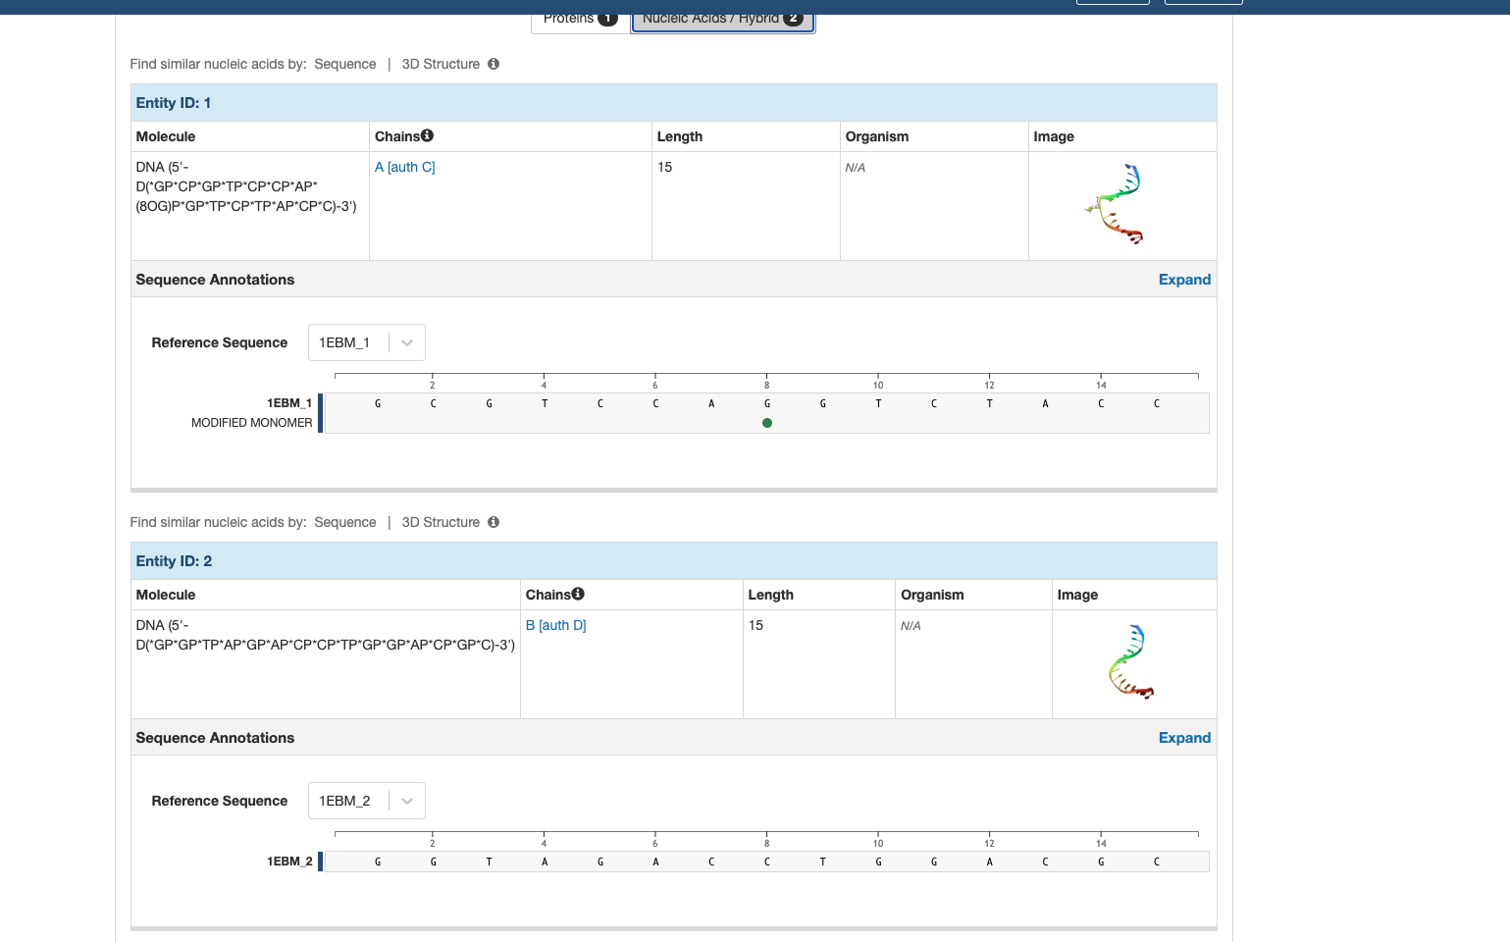

Slide 16
Opening PDBS in Pymol:
Open the 1EBM.PDB in pymol by dragging or entering “load 1ebm.pdb” in the command prompt
Display the sequence using the S button on the lower right-hand part of the screen
Play around with the coloring and view options. Change the whole structure to “cartoon”
In the command prompt type: “select Asp172, chain A & resi 172”. In the selection box change the structure to “sticks”. Change its color to be distinct from the rest of the structure.
What kind of secondary structure element is Asp172 located in?
Let's show the main protein structure as sticks. To see the sidechains better let's color the structure gray and then “by element”. You see some residues sticking out into the solvent from the surface of the protein. Let’s create a new selection with them (hold shift to box select). Would you describe the side chains of these residues as hydrophilic or hydrophobic? Can you find any areas within the structure that are rich in hydrophobic residues? What forces are stabilizing the structure in these regions?
Select the residues 151-167 using the command prompt (select alphahelix, Chain A & resi 151-167). Show as sticks and color by element. Which atoms are involved in H-bonds? What function do these bonds play? To view the H-bonds first enter “set h_bond_max_angle, 30” in the command prompt then goto Actions → Find → Polar contacts → Within selection.
Create a new selection called OGG1 using just chain A: “select OGG1, Chain A”. Locate the N-terminus and the C-terminus. Are their any gaps in the protein backbone? Which residues are missing? Why are they missing?
Notes:
There are 2 β-sheets. They contain 2 and 5 β-strands, respectively. There are more residues in α-helices than in β-sheets.
Asp174 is in a loop (connecting two β-strands).
The residues sticking out into the solvent, for example those I have colored pink below, are charged (Lys, Arg & Glu) or polar (Gln). All these are hydrophilic.
The pink residues (colored manually by me) in the figure below are forming a network of hydrophobic interactions. Hydrophobic interaction forces are stabilizing this region.
The figure below shows the hydrogen bonds stabilizing the α-helix. The H-bonds are between the amide O-atom residue n and the backbone N-atom of residue n+4. There are approximately 4 turns.
There is one gap, between residues 79 and 83, i.e. residues 80-82 are missing. Very likely, they were not visible in the electron density due to structural disorder. In the most recent version of PyMOL, gaps like this are no longer “missing” completely in cartoon rendering. Instead, a dotted loop is shown.
select Calcium, chain C and resn CA

Slide 17
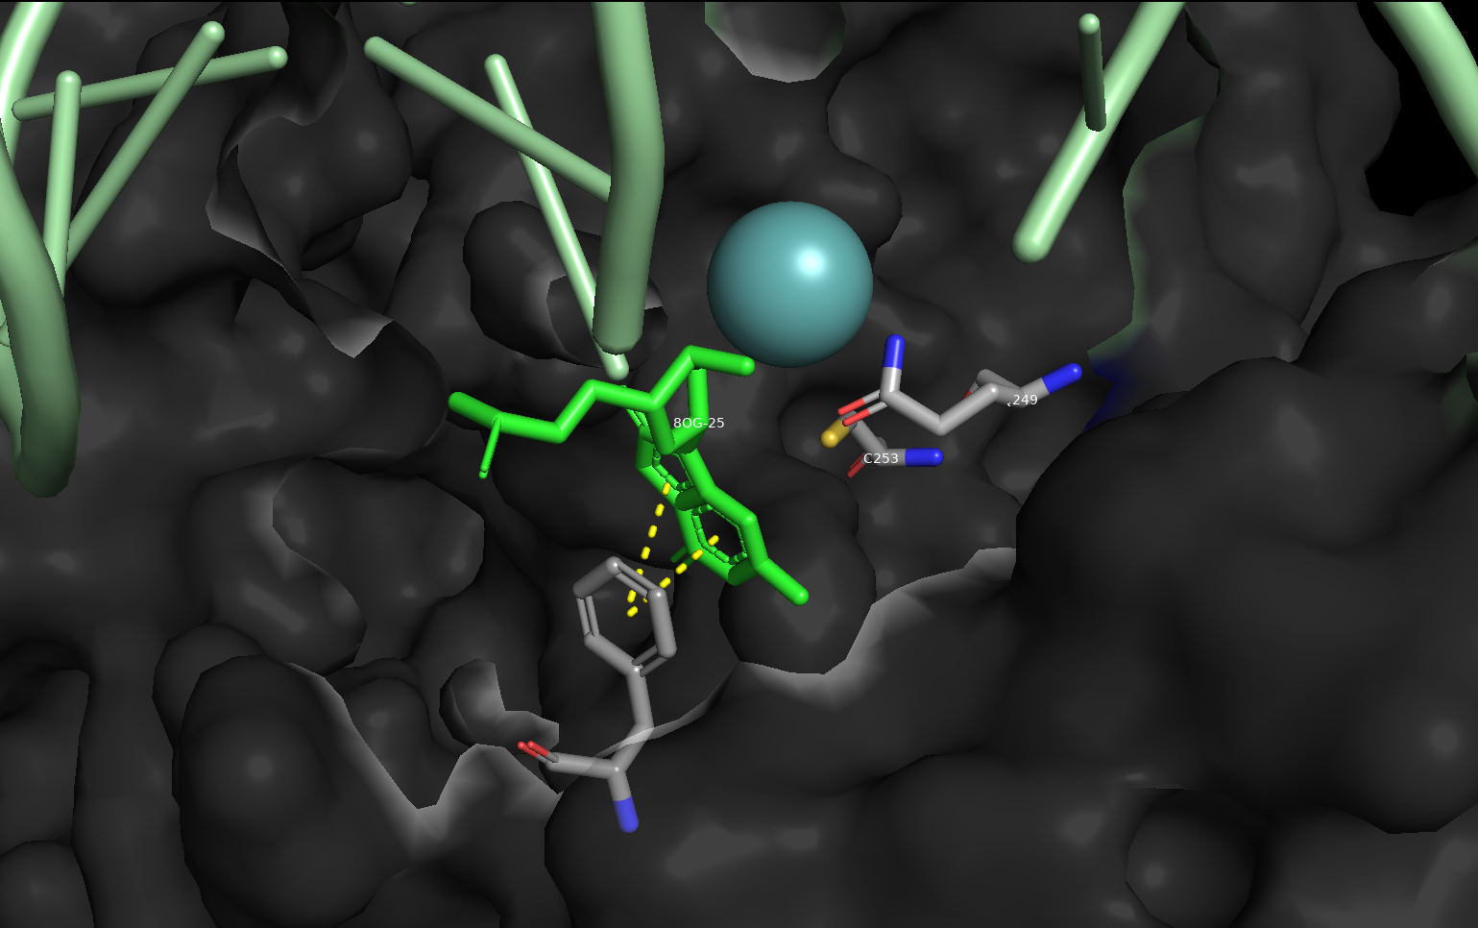
Protein-DNA Interaction
Let's select the DNA portion of out structure: “select DNA, polymer.nucleic”
Let's use a surface style visualization to investigate the curvature and binding pockets of OGG1.
Let's select the active site between the protein and DNA: “select 8oxoG, resn 8OG; select ActiveSite, 8oxoG around 8”
One Phe (319) and one Cys (253) residue are “stacking” against 8-oxoG in the active site pocket. Which ones? Which Interactions do we expect between these peptide residues and DNA bases? (select these residues and use the ‘Actions -> find’ to inspect contacts)
This structure contains the mutant OGG1 K249Q. Can you find residue 249 in the structure? Do you have any suggestions for why the researchers behind this study have mutated this residue?
Notes:
The active site is located in the region where the DNA base is flipped out of the DNA-duplex and inserted into a cavity on the OGG1 surface. See figure below.
The intercalating residue is Asn149.
Wild-type OGG1 (i.e. non-mutated OGG1) is an enzyme that grabs DNA, flips 8-oxoG out of the duplex, excises 8-oxoG using Lys249 as a nucleophile, lets go of the DNA and the excised base, and finally starts over again on the catalytic cycle. Wild-type OGG1 would have “eaten up” all the DNA substrates and would not have created any stable complexes. Lys249 was mutated to make the enzyme inactive. The K249Q mutant grabs DNA, flips the base, but then forms a stable complex that can be crystallized and studied.

Slide 18
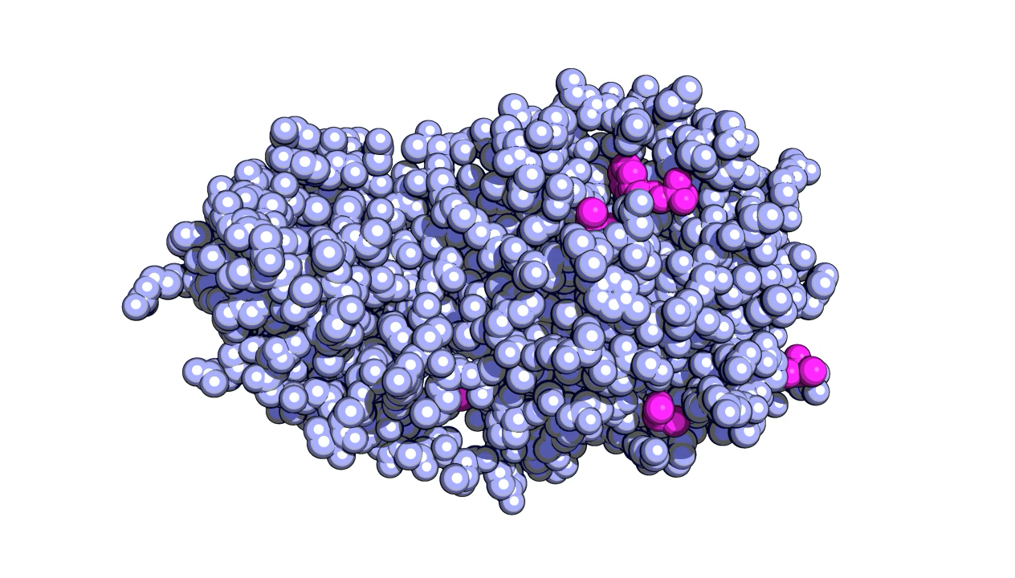
Publication Quality Images:
Selection transparency:
set `representation`_transparency, F, selection
For the value of F, 1.0 will be an invisible and 0.0 a completely solid surface.
Background transparency and color:
bg_color `color`
set ray_opaque_background,0
util.cnc
util.cbc
Ray tracing:
set ray_trace_mode, 1
set antialias, 2
set ray_shadows, on
set ray_trace_color, black
set ray_trace_gain, 0
set ray_trace_fog=0
To render the image type ray
Sars-cov-2 main protease: 5R7Y
Saving:
png `filename`, dpi= 360, ray =1
Notes:
https://pymolwiki.org/index.php/Gallery

Slide 19
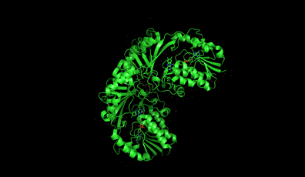
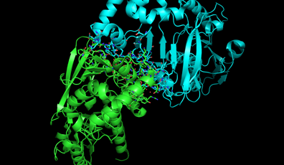
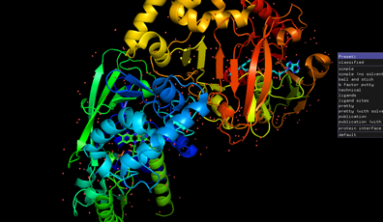
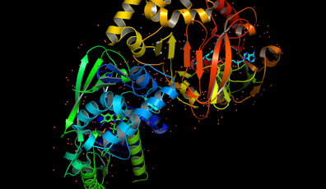
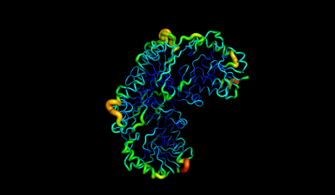
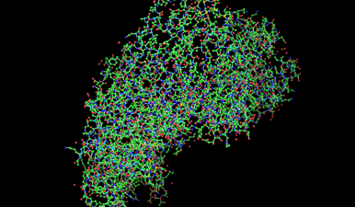
Publication Quality Images: Presets
Normal
Interface
Pretty
Publication
B-Factor
Ball and Stick

Slide 20
Using Pymol Scripts:
You can find pymol scripts at https://pymolwiki.org/index.php/Category:Script_Library
Let’s use the AngleBetweenHelices script to find the angle between alpha-helices and beta-sheets. Downdload the script and type “run /path/to/script/”.
Let’s designate residues 232-241 as the first alpha helix (select a_helix_1, chain A & resi 232-241) and residues 247 to 259 as the second alpha helix (select a_helix_2, chain A & resi 247-259)
Now run “angle_between_helices a_helix_1 a_helix _2” to calculate the angle between them.

Slide 21
Exercise 1:
Use the pdb ID 1KJF to download the pdb file. It is the pdb file for the HIV-1 protease along with a substrate. Use at least three different viewing methods to understand the structure well. List the method used, copy and paste the image for this method and highlight the benefits of each method.
The HIV protease functions as a dimer. Some enzymes that form dimers then have two active sites. Is this the case for the HIV protease? Briefly describe the relationship of the active site and peptide-binding cleft to the subunits of the enzyme.
What kinds of amino acids do you find in the areas of the protein exposed to the water around it (e.g., when the protein is in solution in the cytoplasm)?
If you were to design an inhibitor of the HIV protease, where would you want it to bind? What kind of molecule might you use as the prototype to develop the structure of a good inhibitor?
Using the cartoon or ribbon view, you should be able to identify where a long β-strand on each subunit of the protease makes a hairpin turn, forming flexible flaps that cover the active site cleft. These flaps control access of the substrate to the active site. Which amino acids form the flaps (just give the range of numbers)? Although this region is very important to protease function, why are the flaps not likely to make a good target for rational drug design?
What are the numbers of the amino acids on each chain that form the Asp-Thr-Gly (Asn-Thr-Gly in this mutant) aspartate protease motif in 1KJF?

Slide 22
Exercise 2:
A mutant HIV-1 protease structure is determined by homology modeling using the web-based tools.
Consider the following mutated HIV-1 protease FASTA sequence:
>Mutant_HIV_protease
PQITLWQRPIVTIKIGGQLKEALLNTGADDTVLEEVNLPGRWKPKLIGGIGGFVKVRQYDQVPIEICGHKVIGTVLVGPTPANVIGRNLMTQIGCTLNF
SWISS-MODEL is a Web-based homology modeling program suitable for analysis of the mutant protease; its automated mode provides an easy way to model a protein expected to closely match the template. From the SWISS-MODEL home page, choose Automated Mode and enter the mutant protease sequence. Although the program can search the entire PDB to find a suitable template by similarity, in this case we know the identity of our protein. A suitable template would be an HIV protease structure that also does not include a substrate (because there is no substrate in our mutant sequence); we can use PDB structure 1ODW. Enter this accession number at the bottom of the page to be used as the template; you can enter either chain A or B, because both are the same. You can wait for the results (usually only a few minutes) or provide an email address to be notified when the analysis is complete.
The output of SWISS-MODEL is a PDB file for the mutant protein—a model structure, because it is based not on crystallography but on homology. This structure can be visualized with pymol viewer. View the downloaded structure with pymol. The result should look very familiar. However, it would be more instructive to directly compare the mutant structure with the unmutated protease. Download the PDB model for the mutant using the appropriate link and save it as a local file. Then navigate to PDBeFold, a Web interface to a program capable of constructing a pairwise structure alignment.
How many mutations are there in the mutant protease sequence, as compared with the sequence of the protease you examined in Part I? Use pairwise alignment to find out.
1. In the regions you highlighted, how would you characterize the effect of the mutations on the structure of the protein, in general?
2. How would these structural changes affect the binding of a small inhibitor molecule to the protease active site? Why would they have less effect on the binding of the natural substrate?
3. If you wanted to design a drug that would inhibit this mutant protease, what characteristics would you want it to have?
4. Change the colors of your model so that everything is white except the three amino acids of the aspartyl protease motif (make the substrate gray for contrast). Make these three amino acids blue on the mutant chains, and then see what happens when you color them red on the nonmutant chains. Does their position change in the mutant relative to the unmutated protein? Is this what you expected? Certain changes in the sequence or structure at these positions could lead to drug resistance; why then do we not observe them among drug-resistant HIV isolates?

Slide 23
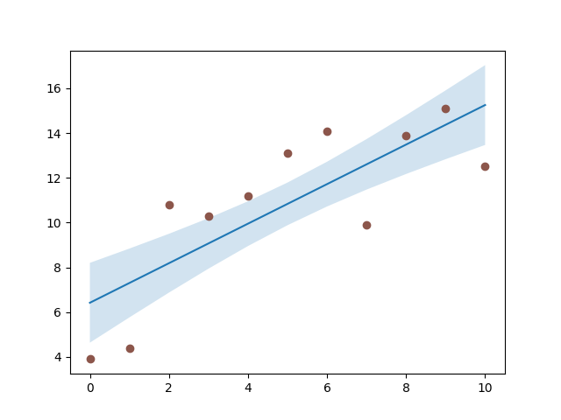
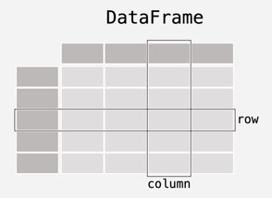


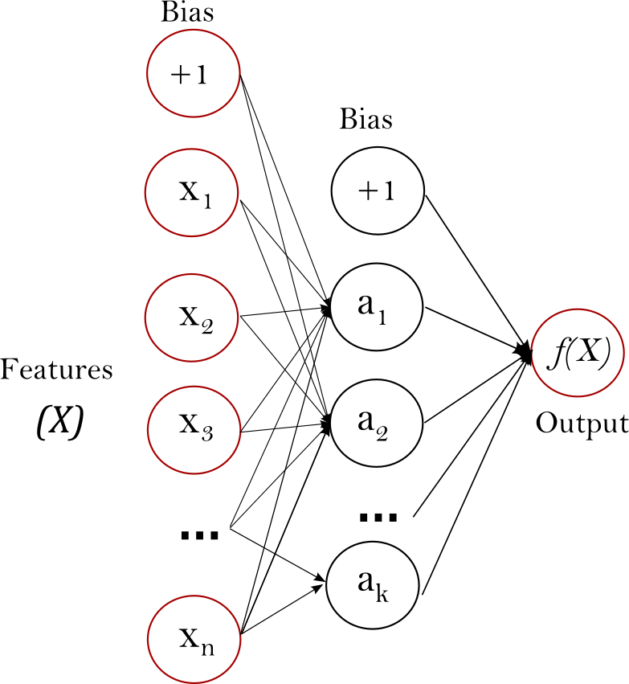
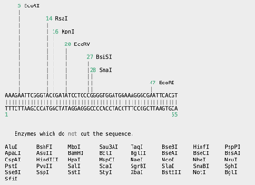


Do More With Python:

